Slide 1
ME 557 Final Project
By Badrinath Balasubramaniam

Slide 2
The Idea
Develop an obstacle navigation game.
Car avoids obstacles and reaches the finish line.

Slide 3
How the Game works
Car is moving forward by default (without keyboard input).
Will change lanes when left and right keys are pressed.
Will have to avoid obstacles.
Obstacles are primitives placed in the scene.

Slide 4
Game Controls
Press R to initiate forward motion of the car.
Press A to move left (change lanes to left).
Press D to move right (change lanes to right).
Guide the car past the blue cubes.

Slide 5
Implements
Keyboard Triggered Animation.
Multi-texturing (The Road is Multi Textured with a picture of a road, a Gorilla, and the sky).
Multiple primitives, and loaded objects.
Trackball Navigation.
Combined light.

Slide 6
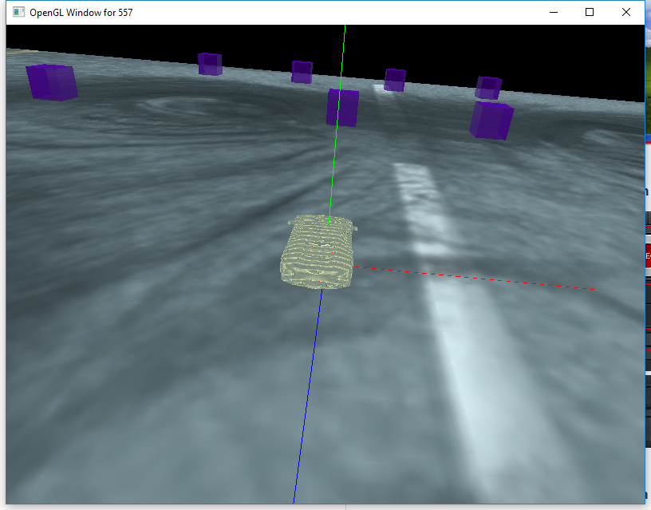
Demonstration ( Note: There is a lag in the video because of the video recording software)

Slide 7
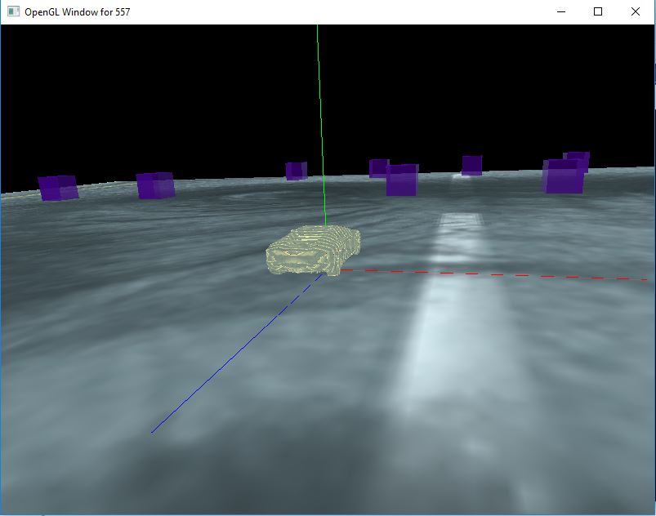
Screenshot

Slide 8
Project Experience
Debugging was (and still is) time consuming.
Needs lots of work on the physics aspect.
Involved combining various techniques taught in the course.
A good learning experience.

